Slide 1
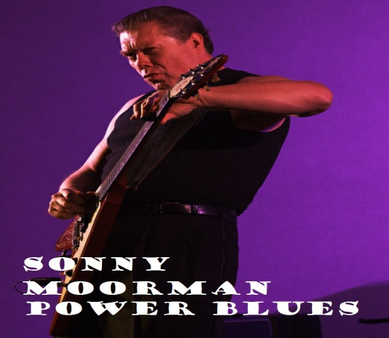
15th Annual
FREEDOM FEST
following the Freedom Ride
THE GOODTIMERS
Supporting our community through the Goodtimers Foundation
August 16, 2015 2PM
GAILEY VFW POST 8326 Brownsway Ln. /off Galbraith Rd. in Groesbeck
OUTSTANDING LIVE MUSIC
FOOD, BEER, VENDORS, RAFFLES and FUN
Biker Food By Fristoe Catering
IF YOU DON’T RIDE THIS IS FOR YOU!
$5.00 DONATION
RAIN OR SHINE THE VFW HAS A LARGE HALL, THE PARTY GOES ON!
More Info and Directions to the VFW:
www.goodtimersfreedomride.com

